Slide 1
Employee Attrition Why We Need to Reduce?
Fadel Ahmad Fadhilah
Purwadhika JCDS Final Project
16 November 2020

Slide 2
Employee Attrition
Employee attrition is a normal cycle in a company where employees decide to leave, such as retirement, resignation, personal health, new opportunities for advance career, not fit with company culture, and other similar reasons. Attrition seemed to be more voluntary and normal because the influences of attrition come from employee itself rather than company. Due to that, attrition always be compared to turnover, which also have similar things but seemed to be more negative.
However, there are some cons with attrition which cause some problem to the company.
- • Reduction in size or strength of workforce
- • Remaining job duties can increase the work load for remaining employees
- • Losing an employee can lead to the loss of all this acquired knowledge, which is not easily replaceable.
- • Losing an employee can affect the smooth functioning of a team and lead to productivity losses.
- • Losing potential employee
- • Require not small cost for recruitment and training.
I have a dataset from unknown company. I want to look the employee’s characteristic which are doing attrition through the data and predict if the employee will leave the company from the model (I use gradient boosting classifier). The result is expected to give some advice for the company in order to get the employees stay and reduce attrition’s level.
The data is from Kaggle (https://www.kaggle.com/vjchoudhary7/hr-analytics-case-study)

Slide 3
Output and Features
Output variable, divided into 2: Target Yes and Target No
Features: 24
Target: Attrition :Yes, Attrition: No
‘Yes’ means target left the company on the previous year, ‘No’ means target stay on company

Slide 4
Objectives
Gain insight of Employees data to give some advice to the company:
Who are more likely to left the company ?
How is the evaluation of the company from the employee ?
Using machine learning to identifying employees attrition
Training models
Help company to classified employee that likely to leave
Could help company to retain talent employee

Slide 5
DATA PRE PROCESSING
Checking if there is any duplicate data
Checking if there is any inconsistent values in a variable

Slide 6
WORKING FLOW
Data Pre Processing
Exploratory Data Analysis
Feature Engineering
Dropping some columns
Filling Missing Value
Modelling
Logistic Regression
Random Forest Classifier
GradientBoosting
Hyperparamater Tuning
Model Deployment
Dashboard

Slide 7
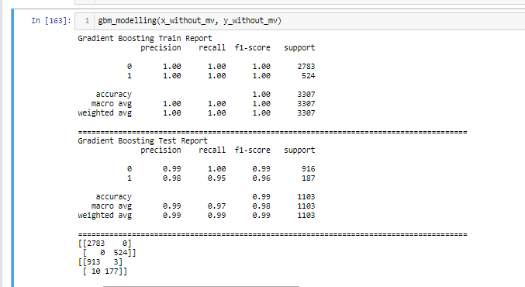
MODEL EVALUATION

Slide 8
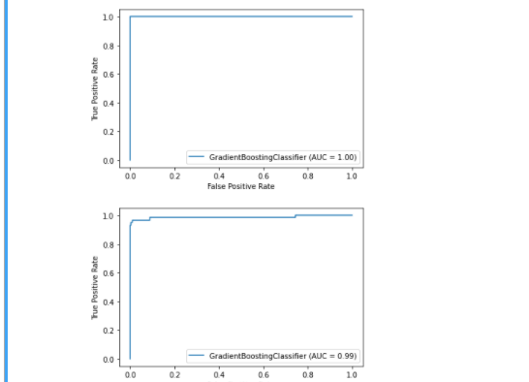
MODEL EVALUATION ROC-AUC

Slide 9
Conclusion
This project help company to gain insight of their employee condition, such us their satisfaction, their performance, their background, their job at the company.
We can continue for specific topic to gain insight for the company, such as factors for satisfaction, training and development, retain system of the company to get better recommendation on how to retain employee

Slide 10
Visualization and;
Model result will be shown at Jupyter Notebook

